Slide 1
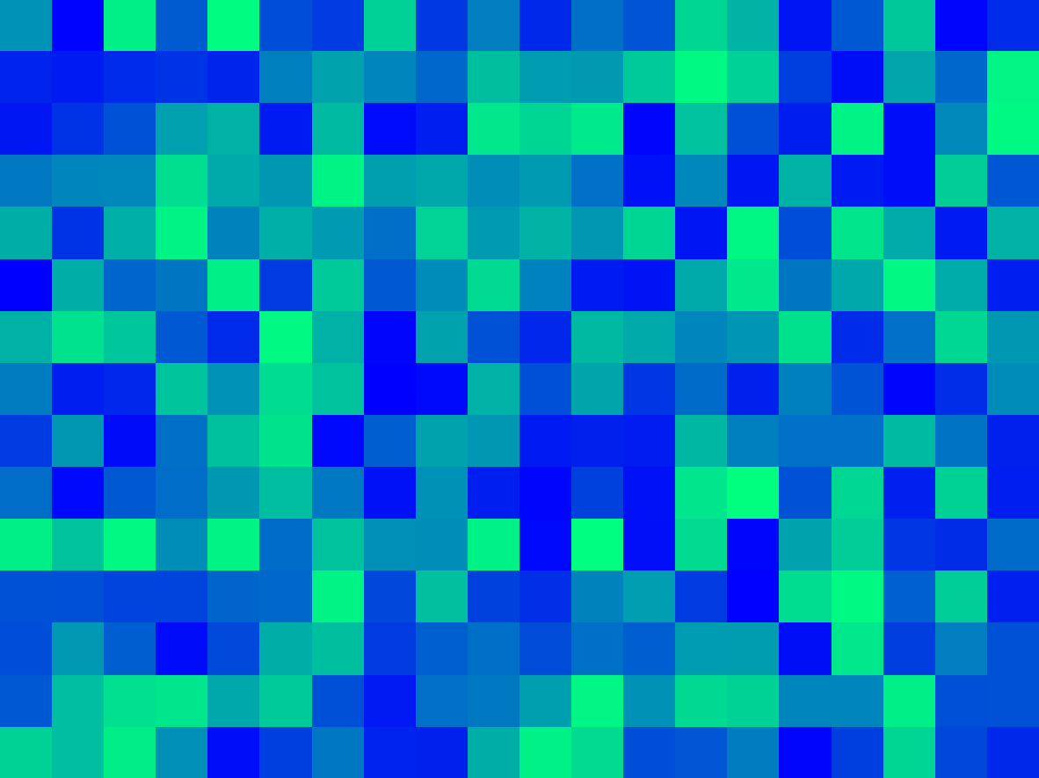
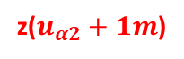
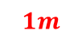

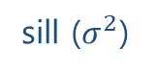
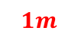
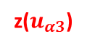
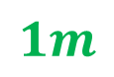
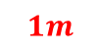
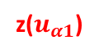
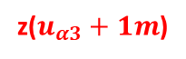
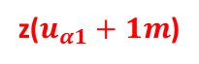

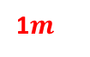
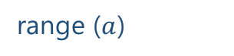

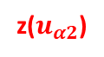
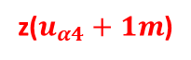
$$1m$$
variance ($γ$)
z($u_{α1}$)
z($u_{α1}+1m$)
sill ($σ^{2}$)
$$1m$$
$$1m$$
1$m$
nugget ($c_{0}$)
z($u_{α4}$)
z($u_{α4}+1m$)
z($u_{α2}$)
z($u_{α2}+1m$)
$$1m$$
range ($a$)
z($u_{α3}$)
z($u_{α3}+1m$)
lag distance (h)

Slide 2
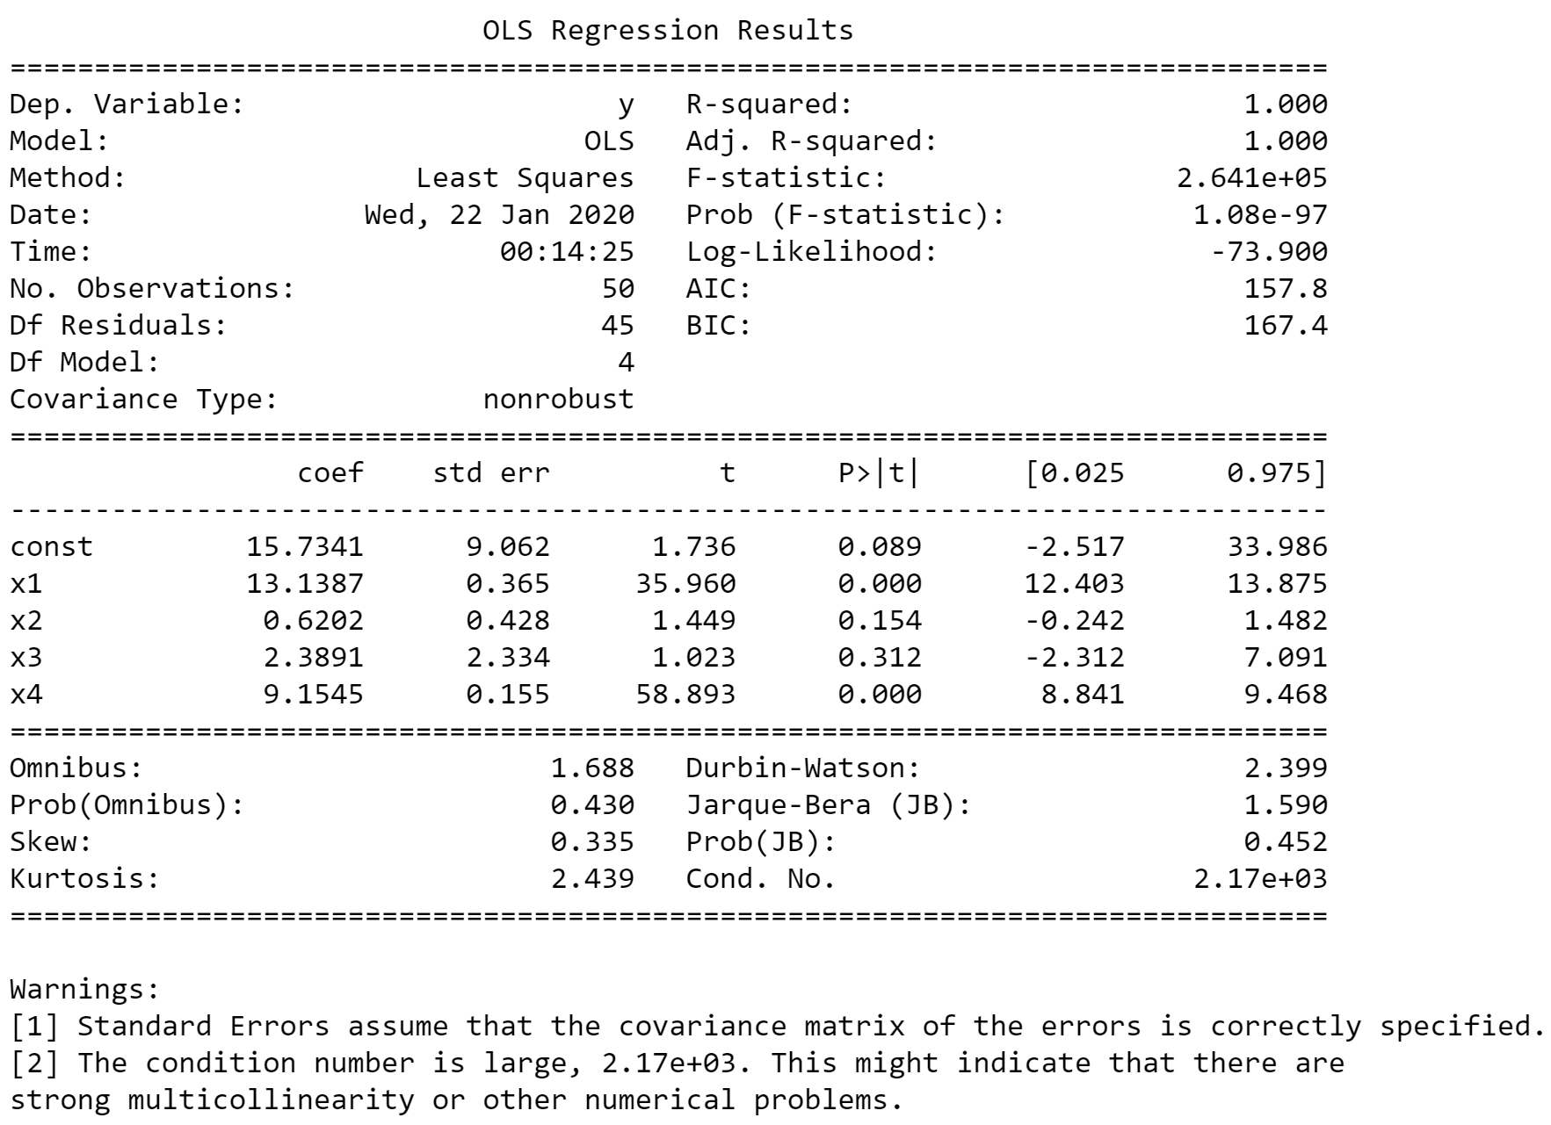
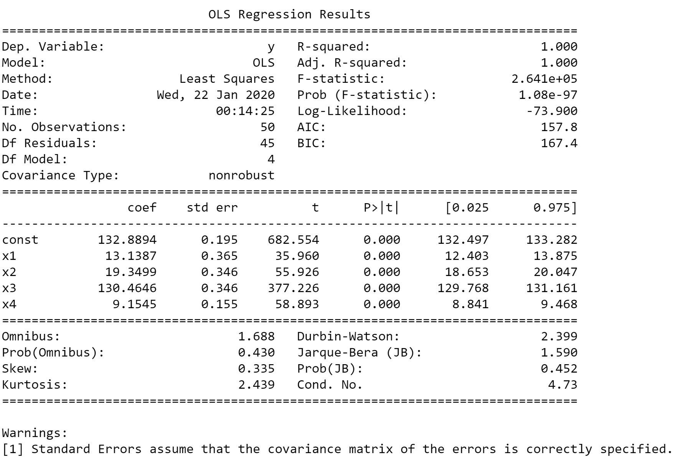
Original
Mean-centered

Slide 3
Original
Mean-centered

Slide 4
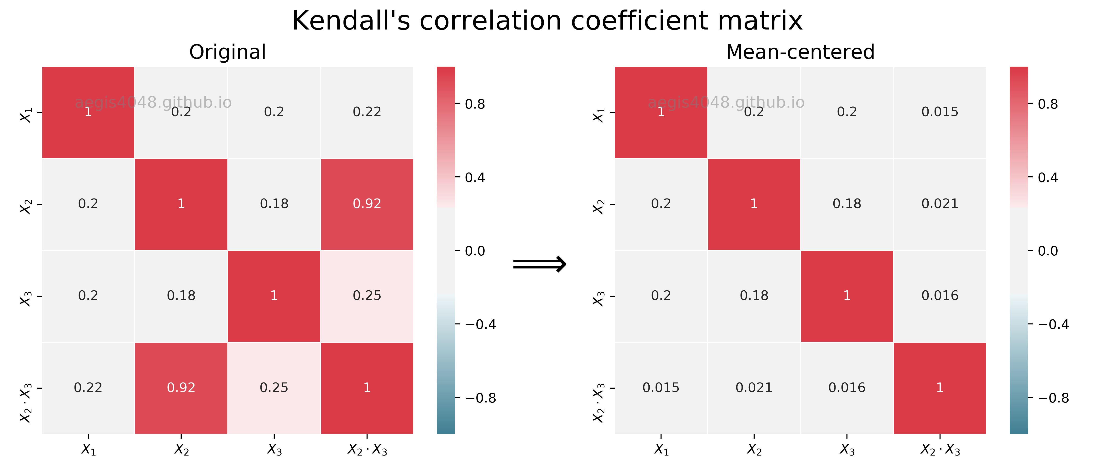
Unaffected
Reduced

Slide 5
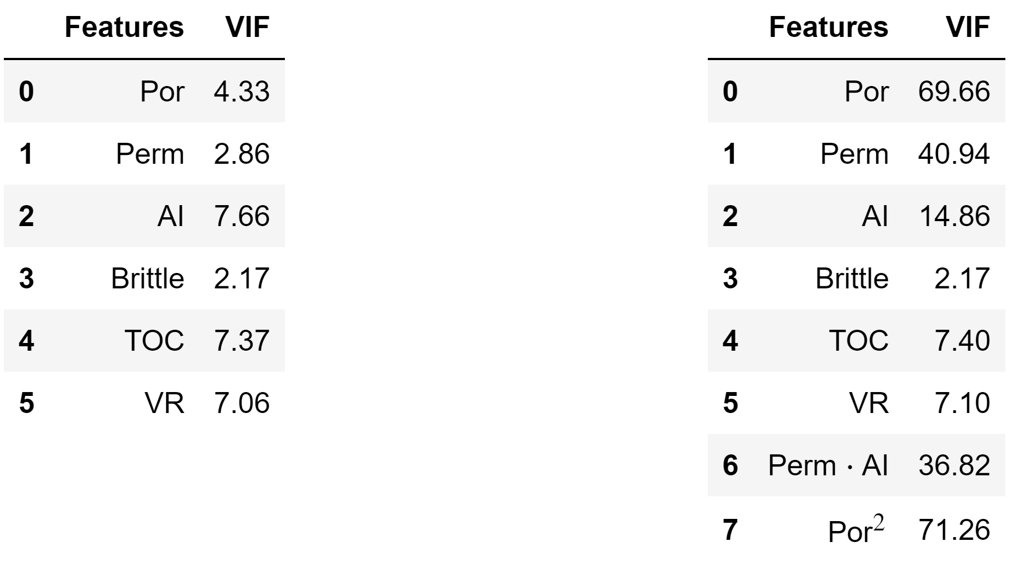
Original data
Interaction terms
VS
aegis4048.github.io
aegis4048.github.io

Slide 6
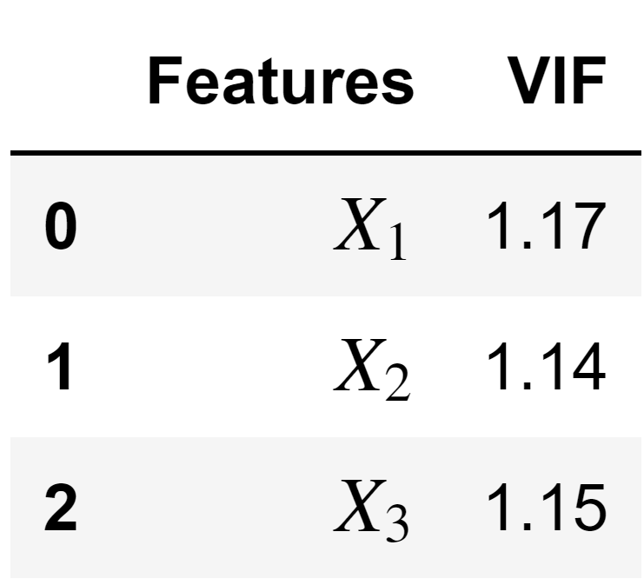
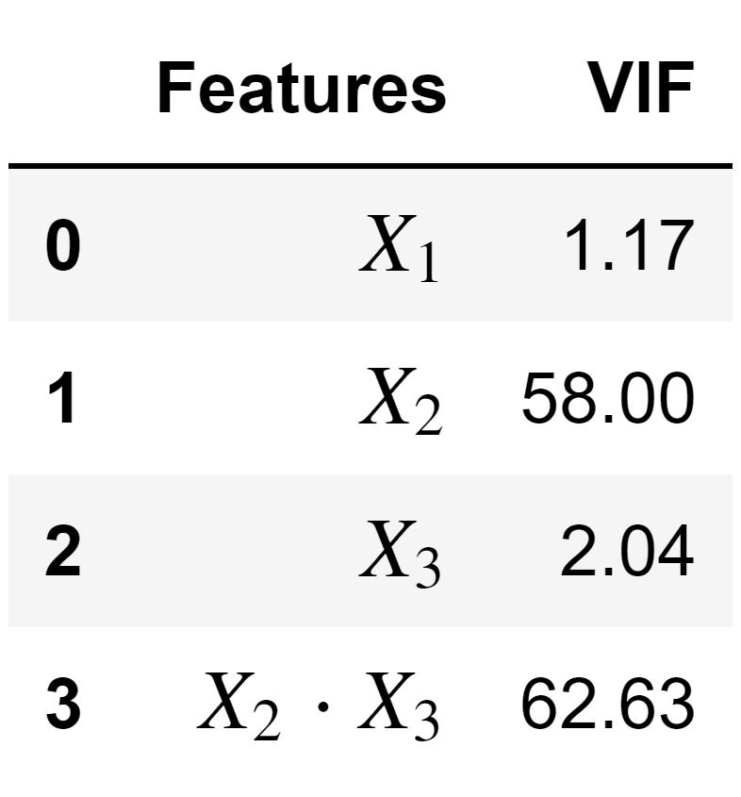
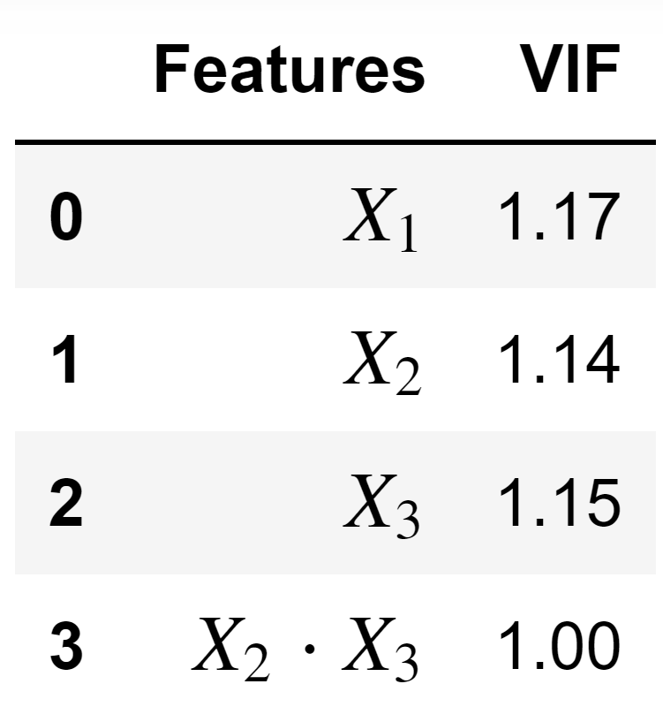
Original
Interaction
Mean-centered
aegis4048.github.io
aegis4048.github.io
aegis4048.github.io

Slide 7
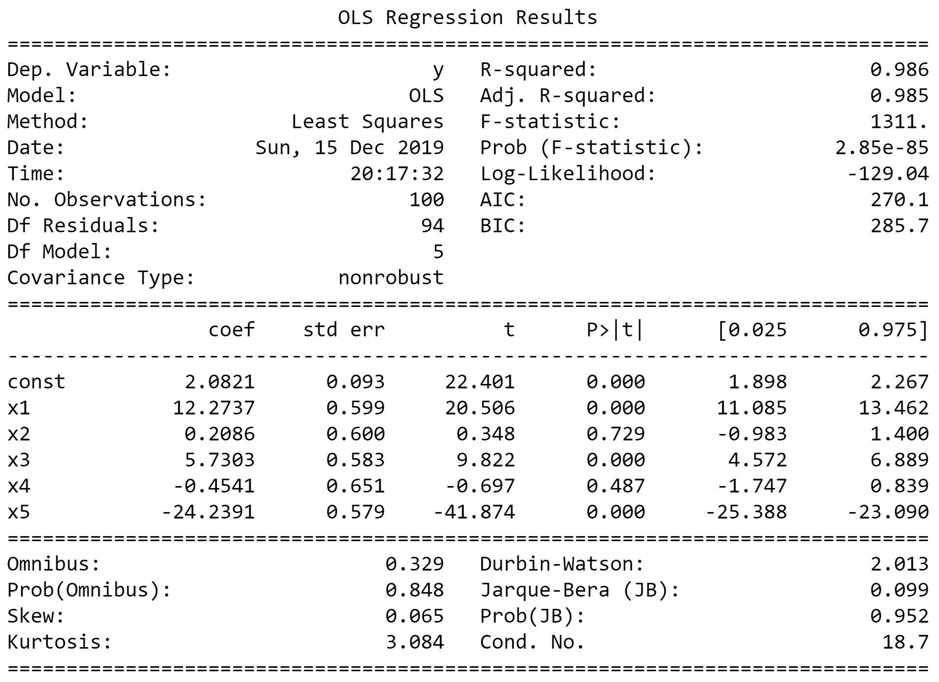
Wrong, due to overestimated std err
aegis4048.github.io

Slide 8
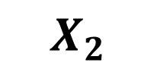
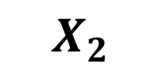
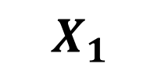
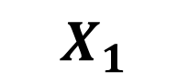
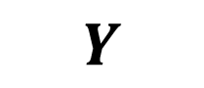
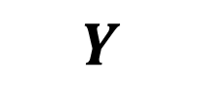
$$X_{1}$$
$$Y$$
$$X_{2}$$
$$X_{2}$$
$$X_{1}$$
$$Y$$
aegis4048.github.io
aegis4048.github.io
A. No Multicollinearity
B. Direct & High Multicollinearity

Slide 9
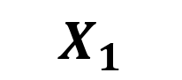
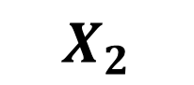
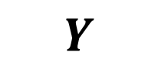
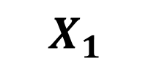
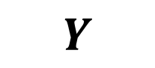
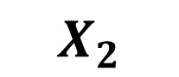
$$X_{1}$$
$$X_{2}$$
$$X_{1}$$
$$Y$$
$$X_{2}$$
aegis4048.github.io
aegis4048.github.io
$$Y$$
C. Indirect & Low Multicollinearity
D. Direct & Low Multicollinearity

Slide 10
Feature of Interest
Collinear Feature
Outcome
Temperature
Positive
Bacteria A
Negative
Bacteria A
aegis4048.github.io
Positive
Toxic Chem.
???
Bacteria B
???
Bacteria A
aegis4048.github.io
aegis4048.github.io
Negative
Bacteria B
Positive
Temperature
Positive
Bacteria A
Negative
aegis4048.github.io

Slide 11
Feature of Interest
Outcome
Temperature
Positive
Bacteria A
Toxic Chem.
Negative
aegis4048.github.io
Bacteria A

Slide 12
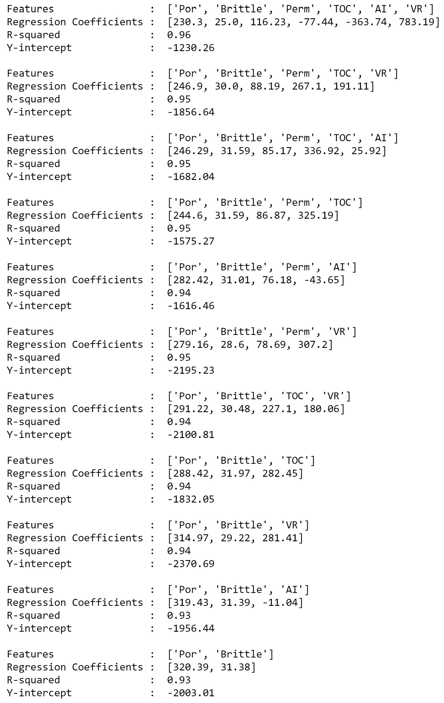
aegis4048.github.io
aegis4048.github.io
Unstable regression coefficient values for ‘Por’

Slide 13

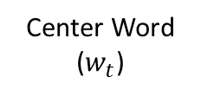
Feature vector
Center Word
($w_{t}$)
man passes sentence should swing sword the who
The
0 0 0 0 0 0 1 0
man
1 0 0 0 0 0 0 0
who
0 0 0 0 0 0 0 1
aegis4048.github.io
sword
0 0 0 0 0 1 0 0

Slide 14
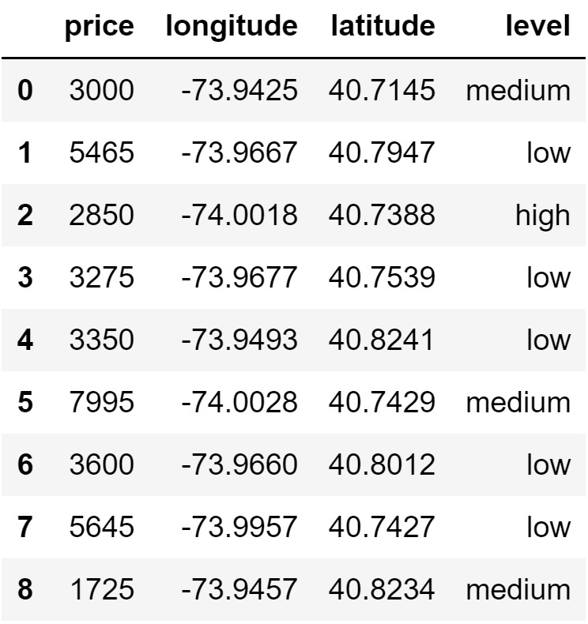
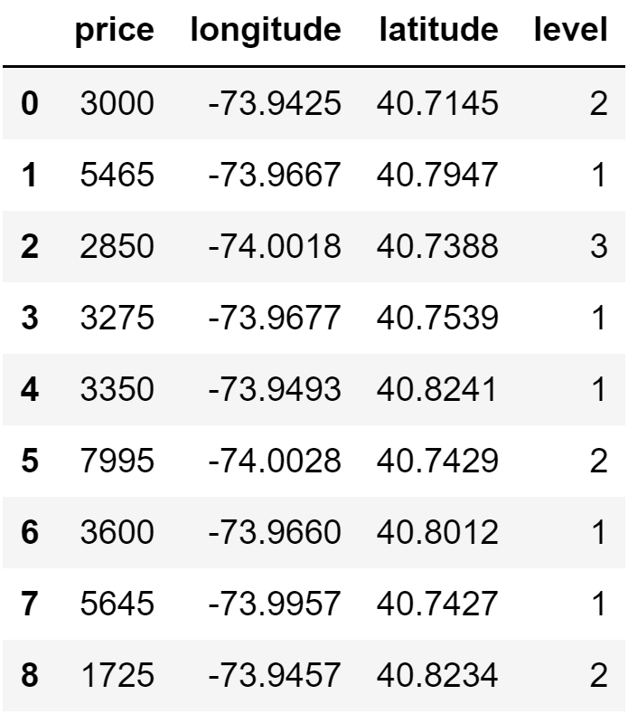
aegis4048.github.io
aegis4048.github.io

Slide 15
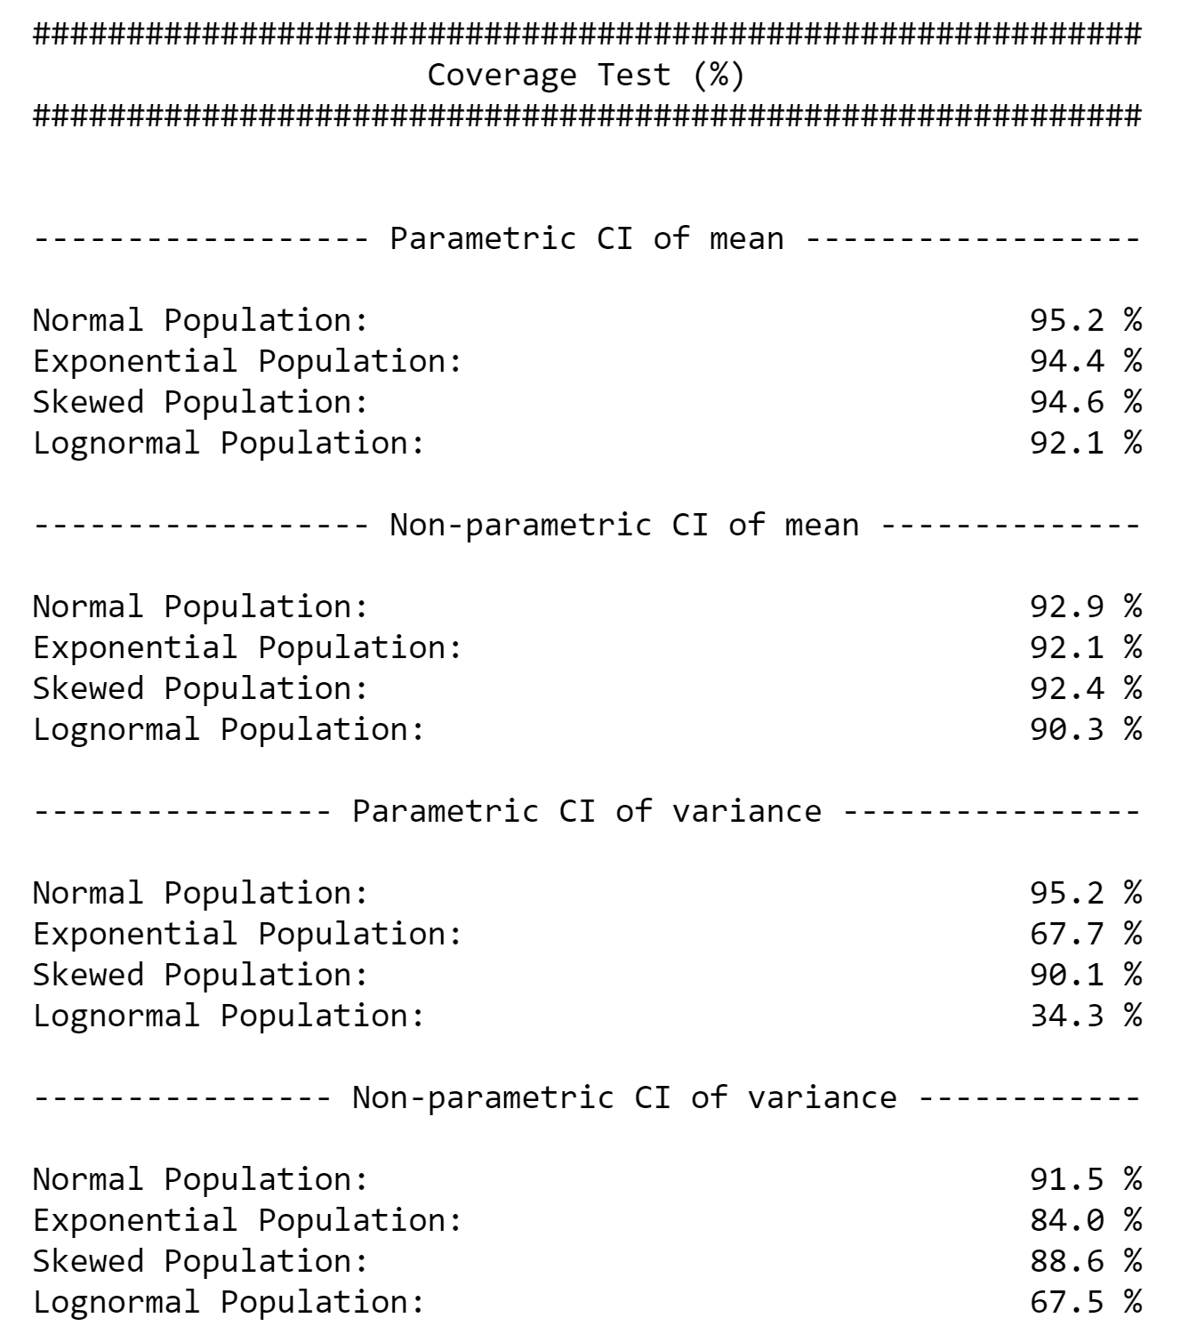
aegis4048.github.io

Slide 16
Direct Sampling
Bootstrap Resampling
VS.
5
7
8
5
12
17
8
11
13
6
4
15
6
2
3
4
10
2
9
14
1
16
Bootstrap population = Original sample
Population
aegis4048.github.io
6
5
5
6
6
5
4
2
4
2
6
8
5
4
8
8
2
8
8
2
5
5
4
4
2
8
6
6
2
Bootstrap
sample (n=5)
Bootstrap
sample (n=5)
Bootstrap
sample (n=5)
Bootstrap
sample (n=5)
Bootstrap
sample (n=5)
4
Mean = 5.2
Mean = 4.2
Mean = 5.2
Mean = 5.0
Mean = 5.4
Original sample
Bootstrap Samples
ANALYSIS
ANALYSIS

Slide 17
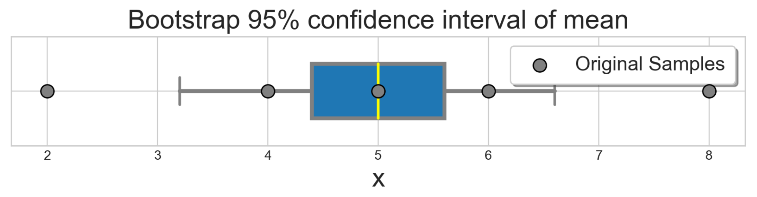


8
5
Original sample (n=5)
6
2
4
Monte-Carlo iteration of bootstrap $r=6$ times
aegis4048.github.io
6
6
6
5
8
5
5
8
4
6
2
4
2
8
6
4
8
8
2
8
5
2
5
4
4
2
8
6
8
2
Bootstrap
sample (n=5)
Bootstrap
sample (n=5)
Bootstrap
sample (n=5)
Bootstrap
sample (n=5)
Bootstrap
sample (n=5)
Bootstrap
sample (n=5)
Mean = 5.2
Mean = 4.2
Mean = 5.2
Mean = 5.0
Mean = 5.4
Mean = 6.4
aegis4048.github.io
$r=6$ bootstrap sample means

Slide 18
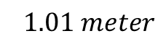
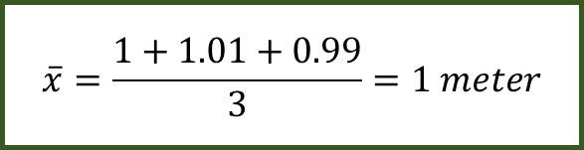
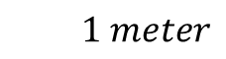
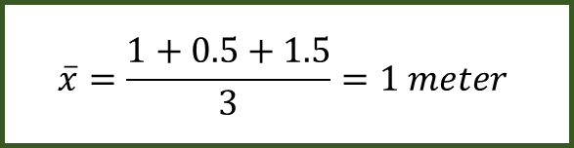
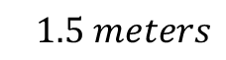
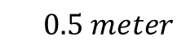
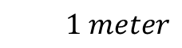
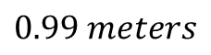
$$1 meter$$
$$\overline{x}=\frac{1+0.5+1.5}{3}=1 meter$$
$$0.5 meter$$
$$1.5 meters$$
aegis4048.github.io
$$1 meter$$
$$\overline{x}=\frac{1+1.01+0.99}{3}=1 meter$$
$$1.01 meter$$
$$0.99 meters$$
aegis4048.github.io

Slide 19
Mode 1
Mode 2
Median 1
Median 2
Mean 1
Mean 2
Overlap of 95% Conf. Int. of Means
aegis4048.github.io

Slide 20
Mean
Median
Fig (a)
Fig (b)
Mode
Mode
Median
Mean
95% Conf. Int. of Mean
95% Conf. Int. of Mean
aegis4048.github.io
aegis4048.github.io

Slide 21
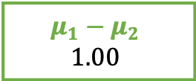




95% chance that difference in mean
falls between -1.31 and 3.31
Lower Limit
Lower Limit
-1.31
3.31
95% Conf. Int. of Difference in Mean
$$1.00 ±2.31$$
$$H_{0}: μ_{1}−μ_{2}=0$$
$$0.00$$
aegis4048.github.io
$$H_{1}: μ_{1}−μ_{2}≠0$$
$$H_{1}: μ_{1}−μ_{2}≠0$$
$$μ_{1}−μ_{2}$$
$$1.00$$
2.5%
outliers
2.5%
outliers

Slide 22




Similar “enough”
“Significantly” different
aegis4048.github.io
aegis4048.github.io
$$μ_{1}$$
$$μ_{2}$$
$$μ_{1}$$
$$μ_{2}$$

Slide 23



























Population
Samples
aegis4048.github.io
sample set 1
aegis4048.github.io
aegis4048.github.io
sample set 2

Slide 24


Depends on type of distribution. Tells how many standard deviation away is the limit from the center
point estimate $±$ (dist.score $×$ SE)
= 12.32 $±$ (1.96 $×$ 1.816)
= 12.32 $±$ 3.56
Depends on type of statistic you want to compute.
For sample mean ($\overline{x}$): ${SE}_{\overline{x}}=s/{\sqrt{N}}$
For sample proportion ($p$): ${SE}_{p}=\sqrt{{p(1−p)}/N}$

Slide 25



Distribution of Population
falls between 4.70 and 24.42
Lower Limit
Lower Limit
4.70
24.42
95% Conf. Int. of Mean
$$12.32 ±3.56$$
$$8.76 \sim 15.88$$
Population Mean (unknown)
$$14.56$$
Sample Mean
$$12.32$$
aegis4048.github.io

Slide 26














Lower Limit
95% chance that population mean
falls between 8.76 and 15.88
Upper Limit
8.76
15.88
95% Conf. Int. of Mean $=12.32 ±3.56$
$$−3.56$$
$$+3.56$$
$$−(dist.score×SE)$$
$$+(dist.score×SE)$$
aegis4048.github.io
3.56 = distribution score $×$ Standard Error
2.5%
outliers
2.5%
outliers
Sample Mean = $12.32$
$$μ_{1}$$
$$μ_{2}$$
5% chance
$$μ_{3}$$
$$μ_{4}$$
$$μ_{5}$$
$$μ_{6}$$
$$μ_{7}$$

Slide 27


100% chance that your clip length
falls between 2cm and 3cm
2.?? cm
depends on tick mark spacing
1
2
3
4
5
6
7
8
point estimate $±$ measurement E.
2.5 $±$ 0.5 cm
cm
aegis4048.github.io

Slide 28

aegis4048.github.io
aegis4048.github.io

Slide 29


Slide 30

aegis4048.github.io
aegis4048.github.io

Slide 31

aegis4048.github.io
aegis4048.github.io

Slide 32

aegis4048.github.io
aegis4048.github.io

Slide 33

aegis4048.github.io
aegis4048.github.io

Slide 34

aegis4048.github.io
aegis4048.github.io

Slide 35

aegis4048.github.io
aegis4048.github.io

Slide 36

aegis4048.github.io
aegis4048.github.io

Slide 37

aegis4048.github.io
aegis4048.github.io

Slide 38

aegis4048.github.io
aegis4048.github.io

Slide 39

aegis4048.github.io
aegis4048.github.io

Slide 40

aegis4048.github.io

Slide 41

aegis4048.github.io

Slide 42


Binomial Classification
(regression, logistic)
(regression, zebra)
(regression, machine)
(regression, pimples)
(regression, sigmoid)
VS
(regression, Gangnam-Style)
(regression, supervised)
(regression, toothpaste)
aegis4048.github.io
(regression, neural)
(regression, idiot)
Likely to observe
$$p(D=1|w,c_{pos})≈1$$
Unlikely to observe
$$p(D=1|w,c_{neg})≈0$$

Slide 43



True: $σ\left(x\right)$ > 0.5
False: $σ\left(x\right)$ < 0.5
aegis4048.github.io

Slide 44

aegis4048.github.io
aegis4048.github.io

Slide 45










Center word: drilling
$$K=5$$
$$iter=1$$
$$iter=2$$
$$iter=3$$
$$iter=4$$
Current context word: engineer
$$p\left(D=1 | w_{drilling},c_{engineer}\right)$$
$$p(D=1|w_{drilling},c_{minimized})$$
$$p(D=1|w_{drilling},c_{primary})$$
$$p(D=1|w_{drilling},c_{concerns})$$
$$p(D=1|w_{drilling},c_{led})$$
$$p\left(D=1 | w_{drilling},c_{page}\right)$$
0.432
0.312
0.565
0.102
0.853
0.642
0.653
0.169
0.221
0.043
0.532
0.380
0.853
0.042
0.083
0.009
0.115
0.101
0.998
0.000
0.001
0.000
0.001
0.002
engineer
minimized
Update $θ$
Update $θ$
Update $θ$
primary
$$=$$
concerns
led
aegis4048.github.io
aegis4048.github.io
aegis4048.github.io
page

Slide 46
Drilling fluids serve to balance formation pressures while drilling to ensure wellbore stability. They also carry cuttings to the surface and cool the bit. The drilling engineer traditionally designs drilling fluids with two primary goals in mind:
To ensure safe, stable boreholes, which is accomplished by operating within an acceptable mud-weight window
To achieve high rates of penetration so that rig time and well cost can be minimized
These primary considerations do not include well productivity concerns. A growing recognition of the importance of drilling-induced formation damage has led to the use of drill-in fluids (fluids used to drill through the pay zone) that minimize formation damage. This page discusses the formation damage that may be associated with various types of drilling fluids.
current context word
aegis4048.github.io
aegis4048.github.io

Slide 47

Vanilla Skip-Gram
aegis4048.github.io
aegis4048.github.io
Negative Sampling
aegis4048.github.io
aegis4048.github.io

Slide 48




Complexity = $O\left(V+V\right)≈O\left(V\right)$
where $V$ is very large
Computed $V$ times
for all vocabs
aegis4048.github.io
$V$ computations are needed to get normalization factor

Slide 49

aegis4048.github.io

Slide 50


aegis4048.github.io
aegis4048.github.io

Slide 51


aegis4048.github.io
aegis4048.github.io
aegis4048.github.io
aegis4048.github.io
aegis4048.github.io

Slide 52

aegis4048.github.io
aegis4048.github.io
aegis4048.github.io
aegis4048.github.io
aegis4048.github.io
aegis4048.github.io

Slide 53

aegis4048.github.io
aegis4048.github.io

Slide 54

aegis4048.github.io
aegis4048.github.io
aegis4048.github.io
aegis4048.github.io
aegis4048.github.io
aegis4048.github.io

Slide 55


aegis4048.github.io
aegis4048.github.io
aegis4048.github.io
aegis4048.github.io
aegis4048.github.io
aegis4048.github.io

Slide 56





$$iter=1$$
$$iter=2$$
$$iter=3$$
$$iter=4$$
0.24
0.42
0.20
0.12
-0.74
-0.82
0.18
0.30
0.12
0.09
-0.32
-0.46
0.08
0.12
0.04
0.02
-0.12
-0.13
0.01
0.02
0.01
0.00
-0.01
-0.02
man
$$\sum_{c=1}^{C}{e_{c}}=$$
passes
Update $θ$
Update $θ$
Update $θ$
sentence
should
aegis4048.github.io
aegis4048.github.io
the
who

Slide 57





$$c=1$$
$$c=2$$
0.12
0.21
0.10
0.06
-0.87
0.09
0.12
0.21
0.10
0.06
0.13
-0.91
0.24
0.42
0.20
0.12
-0.74
-0.82
man
passes
$$\sum_{c=1}^{C}{e_{c}}=$$
sentence
$$+$$
$$=$$
should
aegis4048.github.io
the
who

Slide 58






$$y_{true}$$
($V$-dim)
$$y_{pred}−y_{true}$$
($V$-dim)
0
0
0
0
1
0
0.12
0.21
0.10
0.06
-0.87
0.09
man
$$y_{pred}$$
($V$-dim)
passes
sentence
$$=$$
should
0.12
0.21
0.10
0.06
0.13
0.09
$$−$$
c = 1
the
who
aegis4048.github.io
0
0
0
0
0
1
0.12
0.21
0.10
0.06
0.13
-0.91
man
$$−$$
passes
sentence
$$=$$
should
c = 2
the
who

Slide 59
Dimension 3
0.11
0.34
0.54
Achieve
Achieve
Success
aegis4048.github.io
aegis4048.github.io
0.51
0.91
0.65
Success
Dimension 1
Vector distance
Dimension 2

Slide 60
Training Samples
Source Text
The
man
who
passes
the
sentence
should
swing
the
sword.
(passes, who)
(passes, the)

Slide 61
Dimension 3
should
passes
0.1 0.2 0.7
passes
aegis4048.github.io
should
-2 0.2 0.8
aegis4048.github.io
Dimension 1
Dimension 2

Slide 62





Makes it positive
$$W_{output}∙h$$
Softmax ($W_{output}∙h$)
$$y_{pred}$$
0.042 0.020
0.006
0.007
-0.005
0.030
0.052
-0.021
0.128
0.125
0.124
0.124
0.122
0.127
0.130
0.120
$$p\left(y_{i}\right)=\frac{e^{y_{i}^{}}}{\sum_{j}{e^{y_{j}}}}$$
aegis4048.github.io
Normalizes to range [0, 1]
Sum($y_{pred})$ = 1

Slide 63

$$W_{input}$$
($V×N$)
man
2 0.5 4
0.1 0.2 0.7
0.3 -2 0.2
-2 0.2 0.8
1 0.7 3
3 5 0.2
passes
sentence
should
aegis4048.github.io
the
who

Slide 64




$$y_{true}$$
($V$-dim)
$$y_{pred}−y_{true}$$
($V$-dim)
0
0
0
0
1
0
0.12
0.21
0.10
0.06
-0.87
0.09
man
$$x$$
($V$-dim)
$$W_{input}$$
($V×N$)
$$h$$
($N$-dim)
$$W_{output}^{T}$$
($N×V$)
$$y_{pred}$$
($V$-dim)
passes
sentence
$$=$$
should
man
0
1
0
0
0
0
2 0.5 4
0.1 0.2 0.7
0.3 -2 0.2
-2 0.2 0.8
1 0.7 3
3 5 0.2
0.12
0.21
0.10
0.06
0.13
0.09
$$−$$
c = 1
passes
the
sentence
0.1
0.2
0.7
0.3 0.1 0.4 -0.4
0.1 0.3 -1.1 0.3
0.1 0.2 0.4 0.1
who
should
aegis4048.github.io
aegis4048.github.io
0
0
0
0
0
1
0.12
0.21
0.10
0.06
0.13
-0.91
man
the
$$−$$
passes
who
sentence
$$=$$
should
c = 2
Input Layer one-hot encoded vector
Word-Embedding matrix – a.k.a “Lookup table”
Hidden (Projection)
Layer for center word (passes)
Word-Embedding matrix for context words (the, who)
Softmax Output
Layer of range
[0, 1)
Sum = 1
the
who
Prediction Error – a.k.a function loss

Slide 65





$$x$$
($V$-dim)
$$W_{input}$$
($V×N$)
$$h$$
($N$-dim)
man
0
1
0
0
0
0
2 0.5 4
0.1 0.2 0.7
0.3 -2 0.2
-2 0.2 0.8
1 0.7 3
3 5 0.2
passes
sentence
0.1
0.2
0.7
Projection of word vector for “passes” from the embedding matrix
should
$$×$$
$$=$$
aegis4048.github.io
the
who

Slide 66







Input Layer ($x$)
($V$-dim)
Assuming Stochastic Gradient Descent…
Center Word
($w_{t}$)
v=0
v=1
v=2
v=3
v=4
v=5
v=6
v=7
man passes sentence should swing sword the who
t=0
The
0 0 0 0 0 0 1 0
t=0
$$θ_{new}=θ_{old}−η∙∇_{θ}J_{0}(θ;w^{(0)})$$
t=1
man
1 0 0 0 0 0 0 0
$$θ_{new}=θ_{old}−η∙∇_{θ}J_{1}(θ;w^{(1)})$$
t=2
who
0 0 0 0 0 0 0 1
$$θ_{new}=θ_{old}−η∙∇_{θ}J_{2}(θ;w^{(2)})$$
aegis4048.github.io
aegis4048.github.io
t=9
sword
0 0 0 0 0 1 0 0
$$θ_{new}=θ_{old}−η∙∇_{θ}J_{9}(θ;w^{(9)})$$

Slide 67



Slide 68

killowatt
electricity
aegis4048.github.io
aegis4048.github.io
Oil Producers
Barrels + bpd

Slide 69

Oil Producers
Barrels + bpd
killowatt
electricity
aegis4048.github.io

Slide 70

electricity
killowatt
Barrels + bpd
Oil Producers
aegis4048.github.io

Slide 71
0
0
0.32
0.79
0
0.05
0.10
0
0
0.91
Achieve
aegis4048.github.io
aegis4048.github.io
0
0
0.34
0.75
0
0.10
0
0
0
0.87
Success

Slide 72
Dimension 3
0.11
0.34
0.54
Achieve
Achieve
Success
aegis4048.github.io
aegis4048.github.io
0.51
0.91
0.65
Success
Dimension 1
Dimension 2

Slide 73

aegis4048.github.io

Slide 74













2$m$
variance ($γ$)
sill ($σ^{2}$)
z($u_{α1}$)
z($u_{α1}+2m$)
2$m$
2$m$
2$m$
z($u_{α4}$)
z($u_{α4}+2m$)
nugget ($c_{0}$)
z($u_{α2}$)
z($u_{α2}+2m$)
2$m$
range ($a$)
range
z($u_{α3}$)
z($u_{α3}+2m$)
lag distance (h)

Slide 75









3$m$
variance ($γ$)
sill ($σ^{2}$)
z($u_{α1}$)
z($u_{α1}+3m$)
3$m$
3$m$
z($u_{α3}$)
z($u_{α3}+3m$)
nugget ($c_{0}$)
range ($a$)
3$m$
range
z($u_{α2}$)
z($u_{α2}+3m$)
lag distance (h)

Slide 76




variance ($γ$)
sill ($σ^{2}$)
nugget ($c_{0}$)
range ($a$)
lag distance (h)

Slide 77


z($u_{α}$)
h
z($u_{α}+h$)

Slide 78








h
z($u_{α1}$)
z($u_{α1}+h$)
h
h
z($u_{α2}$)
z($u_{α2}+h$)
z($u_{α1}$)
z($u_{α}+h$)
h
z($u_{α3}$)
z($u_{α3}+h$)

Slide 80
Y axis (North)
Lag Tolerance
Lag 3
Azimuth
Lag 2
Bandwidth
Lag 1
Azimuth Tolerance
X axis (East)

Slide 81

Z axis (vertical)
Horizontal Major
Horizontal Major
Azimuth
Horizontal Minor
Horizontal Minor
Horizontal Minor
$$θ$$
X axis (East)
Y axis (North)

Slide 82
Y axis (North)
Lag 3
Lag 2
Lag 1
X axis (East)

Slide 83

aegis4048.github.io
aegis4048.github.io
aegis4048.github.io
aegis4048.github.io

Slide 84

aegis4048.github.io

Slide 85

aegis4048.github.io

Slide 86

aegis4048.github.io

Slide 87

aegis4048.github.io

Slide 88

aegis4048.github.io
aegis4048.github.io

Slide 89

aegis4048.github.io

Slide 90

aegis4048.github.io

Slide 91


